Slide 1

Software Development & Best Practices
This Photo by Unknown Author is licensed under CC BY
Lecture 4 – Programming and PHP – Part II

Slide 2
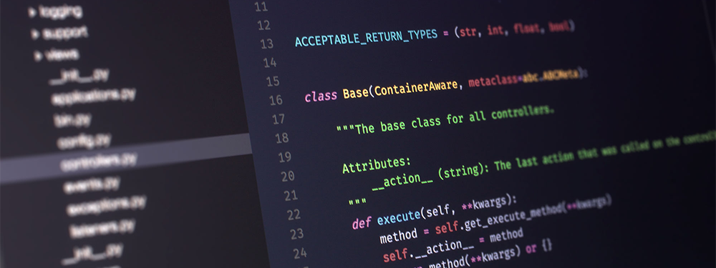
Code Blocks and Conditional Logic
This Photo by Unknown Author is licensed under CC BY-SA-NC

Slide 3

Code Blocks & Conditional Logic
As we have seen with the “?” operator. A computer can take the result of a Boolean expression and use it to decide which piece of code to evaluate.
What happens if we need to do more than evaluate a single expression?
For example, what if we had a game where killing a dragon caused our score to go up by ten points but we also wanted to keep track of the number of dragons we have killed?
score += 10; dragon_kills++;
This Photo by Unknown Author is licensed under CC BY-SA-NC

Slide 4
Code Blocks & Conditional Logic
We need to have a way to tell PHP that a piece of code is only going to be executed under a specific set of circumstances. These pieces of code are called code blocks and we communicate that a piece of code is separate from other code by the use of brace brackets ( { } ) sometimes called “curly brackets”.
However, on their own these brackets do not change what code gets executed! We need one more ingredient…
{ $score += 10; $dragon_kills++; } { $player_lives--; }

Slide 5
IF
What we need are conditional statements. Statements that tell PHP a code block is only executed under a specific circumstance. The simplest conditional is the if statement. As you can see below. If we combine the if statement with a Boolean expression (which we put in brackets) and a code block. We get a block of code that is only executed when the expression evaluates to True.
if ( $arrow_location == $dragon_location ) { $score += 100; $dragon_kills ++; }
if ( $dragon_location == $player_location) { $player_lives--; }

Slide 6
ELSE
Much like in life, many choices are either/or. Either we kill the dragon with our sword, or the dragon gets another chance to attack us.
Because of this, most programming languages contain an else statement. The else statement precedes a code block that only gets executed when the if statement before it does not.
if ( $attack_damage > $dragon_hit_points) { $dragon_death = True; $score += 10; $dragons_slain++; } else { $player_hit_points -= $dragon_damage; }

Slide 7
ELSEIF
So, what happens when you have more than one possibility?
Suppose the player’s attack can do one of four things: Hit, hit-critically (that means a very bad or severe wound), miss, or fumble (the player drops their weapon).
To do this we need a list of options where only one is used. An elseif statement provides this functionality.
if ( $dice_roll == 0 ) { $player_fumble = True; } elseif ( $dice_roll < 10 ) { $player_miss = True; } elseif ( $dice_roll < 20 ) { $player_hit = True; } elseif ( $dice_roll == 20 ) { $critical_hit = True; }

Slide 8
SWITCH/CASE and BREAK
Another way you can pick between a list of options is by using a switch statement. It takes a single expression evaluates it and compares the result against several “cases”.
If the result matches one of these case statements. The code beneath the case statement is executed until the code block ends or a break statement is reached.
The break statement causes the computer to jump to the end of the code block.
switch ($dice_roll) { case 1: $player_hit = True; break; case 2: $player_miss = True; break; case:3: $player_fumble = True; break; }

Slide 9
SWITCH/CASE and BREAK
Because of this, you can get some very strange behavior if you leave out the break statements:
Since there are no break statements in the code on the right. If $a matches any of the case statements, there. PHP will “fall through” to the next case and execu statement even though $a does not match the value in that case statement.
In this example: if $a enters the switch statement with the value 1. Then $a will end up being 4. If $a enters with 3 then $a will be 5 and if $a enters with 5 then $a will be 6. Any other value will not change $a.
switch ($a) { case 1: $a++; case 3: $a++; case:5: $a++; }

Slide 10
SWITCH/CASE and BREAK
If you want a case that will match any other value, then you can use the default statement.
switch ($dice_roll) { case 1: $player_hit = True; break; case 2: $player_miss = True; break; default: $player_fumble = True; break; }

Slide 11
In other languages…
python
C
if dice_roll == 0: player_fumble = True elif dice_roll < 10: player_miss = True else: critical_hit = True
if ( dice_roll == 0) { player_fumble = 1; } else if (dice_roll < 10) { player_miss = 1; } else critical_hit = 1;
RUBY
Java
if dice_roll == 0 player_fumble = true elsif dice_roll < 10 player_miss = true end
if ( dice_roll == 0 ) { result = true; } else if ( dice_roll < 10) { player_miss = true; else { critical_hit = true; }

Slide 12
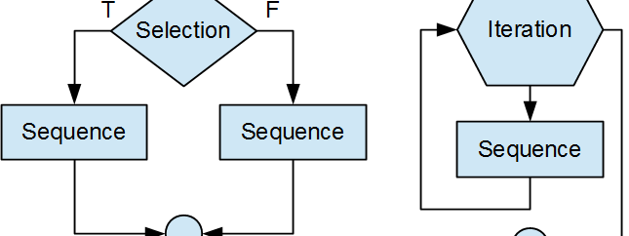
Iterators and Loops
This Photo by Unknown Author is licensed under CC BY

Slide 13
WHILE
Like any game, we almost never need to make a decision only once.
Every time we hit the dragon; we need to check if the dragon is dead. Most programming languages have statements called loops or iterators which allow the computer to accomplish this.
$a = 0;
while ($a < 100) { $a += 7; }

Slide 14
WHILE
In PHP the simplest loop uses the while statement. While executes the code block over and over, until the expression in brackets evaluates to false.
This is called the loop’s exit condition.
Every time a programming language executes the code block of a loop. We call this an iteration.
For a while loop, the exit condition is evaluated at the start of every iteration.
$a = 0;
while ($a < 100) { $a += 7; }

Slide 15
DO…WHILE
Because a while loop evaluates the exit condition at the start of the code block. It is possible for the loop to be skipped entirely if the exit condition is already met.
If we want to make sure our code is executed at least once, we can use a do while loop which only checks the exit condition at the end of the code block -- after the loop has run once.
Example 1: Result - $a = 15
Example 2: Result - $a = 8
$a = 15;
while ( $a > 15 ) { $a -= 7; }
$a = 15;
do { $a -= 7; } while ($a > 15);

Slide 16
FOR
Frequently you will want a loop that will run a specific number of times. To do that you will need to create a variable just to keep track of the number of iterations you want your loop to run. You can see an example of that in the code on the left.
The for loop is a little more straightforward. It has three parts, the initializer, the exit condition, and the increment.
In the code on the right the initializer is $i=0 meaning the loop starts by creating a variable $i with the value of zero. The exit condition is $i < 4 which means the loop ends once $i is no longer less than four. The increment is $i++ which increases the value of $i by one with each iteration.
In both examples, the loop increases the value of $i by one until $i = 4. Each time through the loop $a is increased by the current value of $i. It ends with $a = 6 and $i = 4
$a = 0; $i=0; while ($i < 4) { $a+= $i++; }
$a = 0; for ( $i = 0; $i < 4; $i++) { $a+= $i; }

Slide 17
FOREACH
Suppose your game had a list of player names and you want to display them. The statement to display the contents of a variable is echo. So, it seems reasonable to write something like this:
$player_names = array("Dave","Xaio","Sarah","Li"); for ($i = 0; $i < 4; $i++) { echo $player_names[$i]; }
But since the data is stored in an array, we can do a little better. The foreach loop takes each element in an array and copies it to another variable :
$player_names = array("Dave","Xaio","Sarah","Li"); foreach ( $player_names as $name) { echo $name; }

Slide 18
BREAK/CONTINUE
You may have noticed that all the loops we’ve discussed use exactly one expression to determine if they should exit. What happens if you want a loop to suddenly stop when it meets a different condition? Here we can use the break statement again. In the case statement, break caused PHP to jump out of the code block. Used in a loop it works the same way.
The continue statement on the other hand forces PHP to stop this iteration and go on to the next one. In Example 1, the loop ends with $a = 14 in Example 2, it ends with $a = 26
Example 1:
Example 2:
$a = 0; for ($i = 0; $i < 5; $i++) { $a += 2; if ( $a == 14 ) { break; } $a += 4; }
$a = 0; for ($i = 0; $i < 5; $i++) { $a += 2; if ( $a == 14 ) { continue; } $a += 4; }

Slide 19
In other languages…
python
names = ["Larry", "Xiao", "Kim"] for name in names: print (name)
RUBY
names = ["Larry", "Xiao", "Kim" ] names.each do |c| puts c end
C
const char * names[] = {"Larry", "Xiao", "Kim",}; for ( int i =0 ; i < sizeof(names)/(sizeof(const char *)); i++) printf("%s\n",names[i]);
Java
List<String> names = new ArrayList<>( List.of("Larry","Xiao","Kim"));
for ( String name : names ) {System.out.println(name);}

Slide 20
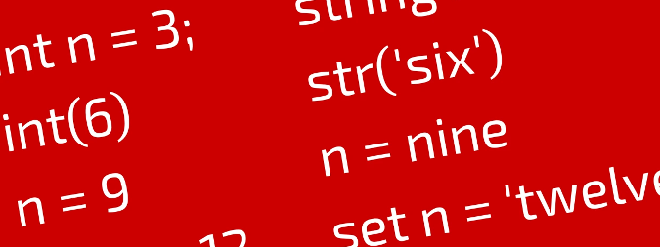
Execution Statements & Built-In Functions
This Photo by Unknown Author is licensed under CC BY-SA

Slide 21
Built-In Functions - printf
Programming languages also have some code that is ready to use. These statement usually cover things like accessing files, outputting data, and using external programs.
We have already seen echo used to send data to the user. However, that’s not the only way to do this. A function which exists in many programming languages is printf. It is short for “print formatted”. It allows you to output data to the user and make it look the way you want it to.
To use it you type printf then a format string, and then a list of variables that you want to output. The example below outputs: “Xiao is 35 years old”.
$name = "Xiao"; $age = 35; printf ("%s is %d years old", $name, $age);

Slide 22
Built-In Functions - printf
This statement works like this: PHP takes the format string and outputs it’s contents until it reaches a “%” sign followed by a single character. In this case: “%s” it then looks that the list of variables and replaces “%s” with the first variable in that list: $name. It then continues outputting the format string until the next “%” sign followed by a single character” “%d” at which point it replaces it with the next variable in the list $age.
So, in the string “%s is %d years old”, “%s” will be replaced by the string Xiao and “%d” will be replaced by the integer 35.
There are many other format strings you can use. For example, “%f” outputs the value as a float (variables with decimals) and “%b” will output the variable in binary code.
$name = "Xiao"; $age = 35; printf ("%s is %d years old", $name, $age);

Slide 23
File system functions – Opening
There are four functions that are included in many programming languages for accessing files: fopen, fread, fwrite and fclose.
To do anything with a file. You first have to tell the operating system you want to use it. This is called “opening the file” which we do with the fopen statement (This can also be used to read data from a URL as you can see below).
fopen requires two pieces of information (which we call parameters). The URL or filename we want to open and the file“mode”.
The mode is a string that tells PHP if you are going to be using this file/URL for reading, writing, or both. An “r” specifies the file is just going to be read. “w” specifies you are just writing to the file. You can also use “rw” to tell PHP you are going to do both! If you’re going to be working with a file that doesn’t just contain text (like an image). You also need to add “b” for “binary”.
You will also need to assign the result of this function to a variable. This is known as a file handle.
$fileHandle = fopen("https://1000logos.net/wp-content/uploads/2016/10/Apple-Logo-1536x864.png","rb");

Slide 24
File system functions - Reading
File handles exist so you can tell PHP which open file you want to work with. As a real-world program often has many files open at once. To get data out of a file (or URL) you not only need to open it with the proper mode, but you also need to tell PHP when you want to read it. You do this with the fread.statement. We tell fread which open file we want to get data from by supplying a file handle as a parameter. We also need to tell it how much data we want to read by giving it an integer with the number of bytes to read. Finally, we assign the result to a variable which catches all the data we are reading.
Often you might not know how much data is in the file/URL. To handle this: we simply keep fetching data until we run out. We can use the feof statement to help here. It returns false if there is more data. To use it, we put it in a while loop and use “!” to keep it running until it returns true.
The code below fetches a PNG file of the Apple Computer logo from a website on the internet.
$data = ""; $fileHandle = fopen(" https://1000logos.net/wp-content/uploads/2016/10/Apple-Logo-1536x864.png ","rb"); while (!feof($fileHandle) ) { $data .= fread($fileHandle,4096);}

Slide 25
File system functions – Writing
Writing to a data file isn’t much different. We still open the file (this time with the “w” mode) but now we use the fwrite function. It takes a file handle, a variable containing the data we want to write and an optional length – in bytes – as parameters. PHP will stop writing either when it’s run out of data or when it’s written the number of bytes in the length field -- whichever comes first.
This code copies the Apple Logo from a website to a file on your webserver. Webservers, by default will not have permission to write files just anywhere but instead of spending time configuring permissions we’ve written the file to /tmp which most applications have access to.
$data = ""; $fileHandle = fopen(" https://1000logos.net/wp-content/uploads/2016/10/Apple-Logo-1536x864.png","rb"); while (!feof($fileHandle) ) { $data .= fread($fileHandle,4096);} $newHandle = fopen("/tmp/copied.png", "wb"); fwrite($newHandle,$data);

Slide 26
File system functions – closing
There are many reasons that a file handle needs to be closed. One is that there are a limited number available. They also consume system resources like RAM and some operations (like writing) often don’t complete until the handle has been closed. Closing them is easy you simply use fclose and pass it the file handle as a parameter.
Here is the program from the last slide rewritten to properly close file handles.
$data = ""; $fileHandle = fopen(" https://1000logos.net/wp-content/uploads/2016/10/Apple-Logo-1536x864.png","rb"); while (!feof($fileHandle) ) { $data .= fread($fileHandle,4096);} $newHandle = fopen("/tmp/copied.png", "wb"); fwrite($newHandle,$data); fclose($newHandle);

Slide 27
External Programs
The TurnKey webmin software that you used for Lab0 is written in the PERL programming language. You’ve probably noticed that you can manage almost the entire machine from it. How does it do this?
The answer is simple. Most programming languages contain a function that allows you to run an operating system command. In PHP, there are several commands such as system and exec.
The example below uses one of the simplest Linux commands: touch -- all it does is create an empty file at the specified location. Again, to save on assigning permissions we will use the /tmp directory.
system("touch /tmp/myfile.txt");

Slide 28
Math
Computers are mathematical machines. In addition to the mathematical operators mentioned in our last module there are dozens of mathematical functions which can be used.
Just as an example, here is a function that generates a random number between 100 and 200!
$my_number = rand(100,200); printf("I have %d brilliant thoughts per second!",$my_number);

Slide 29
In other languages…
python
handle = open("testing.txt","w") handle.write("Hello there!") handle.close()
RUBY
File.open("testing.txt", "w") { |handle| handle.write "Hello there!\n" }
C
FILE* handle = fopen("testing.txt","w"); fwrite("Hello there!\n",13,1,handle); fclose(handle);
Java
FileWriter handle = new FileWriter("testing.txt"); handle.write("Hello there!\n"); handle.close();

Slide 30
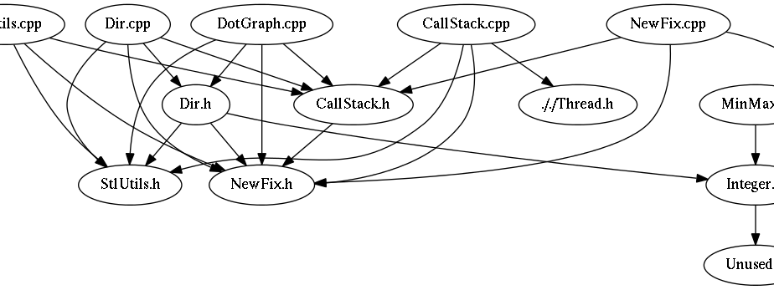
Inclusion
This Photo by Unknown Author is licensed under CC BY-SA

Slide 31
Include/Require
In the real world, it’s very rare to write a program written entirely from scratch. Because of this, most programming languages provide an easy way to add code from other files into your application. PHP has two commands: include and require. Often adding this kind of external code is called adding library.
If you use include and the file you want is missing PHP will only produce a warning (E_WARNING) and the program will continue.
If you use require and the file you want is missing PHP will produce a fatal error (E_COMPILE_ERROR) and stop the script.
Perhaps it goes without saying but the only files that you can include/require are php files.
require "you_need_this.php"; include "another_file.php";

Slide 32

Putting It All Together
This Photo by Unknown Author is licensed under CC BY-SA

Slide 33
A Full PHP Program
In addition to everything we have discussed every programming language requires some extra code to:
Identify what kind of program it is (PHP, Java, etc…)
Provide information the program needs to run (standard libraries, input from the user)
In PHP this is easy. The start of your code is marked by the <?PHP tag and the end is marked by the ?> tag. Everything in between is PHP code.
<?PHP
echo "PHP code always goes between the <?PHP and ?>";
?> <?PHP
echo "You can have more than one program in the same file";
?>

Slide 34
A Full PHP Program
So, what happens to everything else in your file?
Because PHP was designed just to create Server-Side Dynamic Web Pages.
It just gets sent to the web browser as HTML.
This allows you to avoid a lot of unnecessary echo or printf statements.
<HTML><BODY>
<H1>This is the HTML part of my web application</H1>
<?PHP
echo "This the PHP part of my web application</H1>";
?>
</BODY></HTML>

Slide 35
A Full PHP Program
Now that we have all that under our belt. Let’s take a look at a PHP program which generates a random dungeon adventure. Try to see if you can follow what the program is doing just by looking at the code.

Slide 36
A Full PHP Program
So, what happens to everything else in your file?
Because PHP was designed just to create Server-Side Dynamic Web Pages.
It just gets sent to the web browser as HTML.
This allows you to avoid a lot of unnecessary echo or printf statements.
<HTML><BODY> <H1>The Very Short Dungeon!</H1> <p>Welcome Adventurer!</p> <?PHP $room_number = 0; $player_accuracy = 55; $player_damage = 8; $player_health = 100; $monsters = array("A Balrog","An Orc","A Troll","An Evil Wizard"); $monster_health = array(100,20,50,5); $monster_weapon = array("a Flaming Whip","an Axe","sharp claws","a Fireball spell"); $monster_damage = array(8,2,4,10); $monster_accuracy = array(40,60,50,80);

Slide 37
A Full PHP Program
So, what happens to everything else in your file?
Because PHP was designed just to create Server-Side Dynamic Web Pages.
It just gets sent to the web browser as HTML.
This allows you to avoid a lot of unnecessary echo or printf statements.
while ($player_health > 0 ) { printf ("<p>You enter room #%d</p>",++$room_number); $room_contents = rand(0,4); if ($room_contents == 4) { printf("<p>Strange. It appears to be empty</p>"); continue; } else { printf ("<h4>%s with %s is in this room.</h4><p>",$monsters[$room_contents],$monster_weapon[$room_contents]);
$m_health = $monster_health[$room_contents];

Slide 38
A Full PHP Program
So, what happens to everything else in your file?
Because PHP was designed just to create Server-Side Dynamic Web Pages.
It just gets sent to the web browser as HTML.
This allows you to avoid a lot of unnecessary echo or printf statements.
while ($player_health > 0 ) { printf ("<p>You enter room #%d</p>",++$room_number); $room_contents = rand(0,4); if ($room_contents == 4) { printf("<p>Strange. It appears to be empty</p>"); continue; } else { printf ("<h4>%s with %s is in this room.</h4><p>",$monsters[$room_contents],$monster_weapon[$room_contents]);
$m_health = $monster_health[$room_contents];

Slide 39
A Full PHP Program
So, what happens to everything else in your file?
Because PHP was designed just to create Server-Side Dynamic Web Pages.
It just gets sent to the web browser as HTML.
This allows you to avoid a lot of unnecessary echo or printf statements.
while ( $m_health > 0 and $player_health > 0 ) { $attack_roll = rand(1,100); $damage_roll = rand(1,$player_damage); $monster_roll = rand(1,100); $m_damage = rand(1,$monster_damage[$room_contents]); if ($attack_roll < $player_accuracy) { $m_health -= $damage_roll; printf ("You attack and hit for %d points!<br>",$damage_roll); if ( $m_health < 1 ) { printf("You killed it!<br>"); $player_accuracy+5; break; } } else { printf ("You attack and miss!<br>"); } if ( $monster_roll < $monster_accuracy[$room_contents]) { $player_health -= $m_damage; printf ("%s attacks and hits you with %s for %d points!<br>",$monsters[$room_contents],$monster_weapon[$room_contents],$m_damage); } else { printf ("%s attacks and misses<br>",$monsters[$room_contents]); } }

Slide 40
A Full PHP Program
So, what happens to everything else in your file?
Because PHP was designed just to create Server-Side Dynamic Web Pages.
It just gets sent to the web browser as HTML.
This allows you to avoid a lot of unnecessary echo or printf statements.
}
}
printf("<p>You have died after exploring %d rooms.</p>",$room_number);
?>

Slide 41
A Full PHP Program
The Very Short Dungeon!
Welcome Adventurer!
You enter room #1
Strange. It appears to be empty
You enter room #2
An Evil Wizard with a Fireball spell is in this room.
You attack and hit for 1 points! An Evil Wizard attacks and hits you with a Fireball spell for 10 points! You attack and miss! An Evil Wizard attacks and hits you with a Fireball spell for 7 points! You attack and hit for 5 points! You killed it!
You enter room #3

Slide 42
Media References
Read the PHP manual pages for the following. There are important details in them.
printf : https://www.php.net/manual/en/function.printf.php fopen : https://www.php.net/manual/en/function.fopen.php fread : https://www.php.net/manual/en/function.fread.php feof : https://www.php.net/manual/en/function.feof.php fwrite : https://www.php.net/manual/en/function.fwrite.php fclose : https://www.php.net/manual/en/function.fclose.php fprintf : https://www.php.net/manual/en/function.fprintf.php rand : https://www.php.net/manual/en/function.rand.php

